Slide 1
Digital Portfolio
STUDENT NAME: Akash D
REGISTER NO AND NMID: asunm11521222401267
DEPARTMENT: B.sc(Computer Science)
COLLEGE: Sri Subramaniya Swamy Government Arts college

Slide 2
PROJECT TITLE
"My First Web Portfolio: Learning HTML, CSS & Java Basics"

Slide 3
AGENDA
• Problem Statement
• Project Overview
• End Users
• Tools and Technologies
• Portfolio Design and Layout
• Features and Functionality
• Results and Screenshots
• Conclusion
• GitHub Link

Slide 4
PROBLEM STATEMENT
As a beginner in computer science, I wanted to create a simple digital portfolio to showcase my learning journey. I faced challenges like understanding basic syntax, layout design, and how to connect different parts of a webpage.

Slide 5
PROJECT OVERVIEW
This project is a basic student portfolio website built using HTML and CSS. It includes sections like About Me, Skills, Projects, and Contact Info. I also added a small Java script to demonstrate my coding practice.

Slide 6
WHO ARE THE END USERS?
• Myself (to track progress)
• Teachers (for review and feedback)
• Friends and classmates (to share ideas)
• Future recruiters (as I grow my skills)

Slide 7
TOOLS AND TECHNIQUES
• HTML for structure
• CSS for styling
• Java for basic scripting
• Code Pen as my editor
• GitHub for version control and sharing

Slide 8
PORTFOLIO DESIGN AND LAYOUT
• Simple layout with a header, navigation bar, and footer
• Light color scheme for readability
• Responsive design using basic CSS media queries
• Organized sections with clear headings
Responsive layout(mobile + desktop view)

Slide 9
FEATURES AND FUNCTIONALITY
• About Me section with a short intro
• Skills section listing HTML, CSS, and Java scripts
• Projects section with screenshots and descriptions
• Contact form (non-functional, just for design practice)
• Java script that prints a welcome message

Slide 10
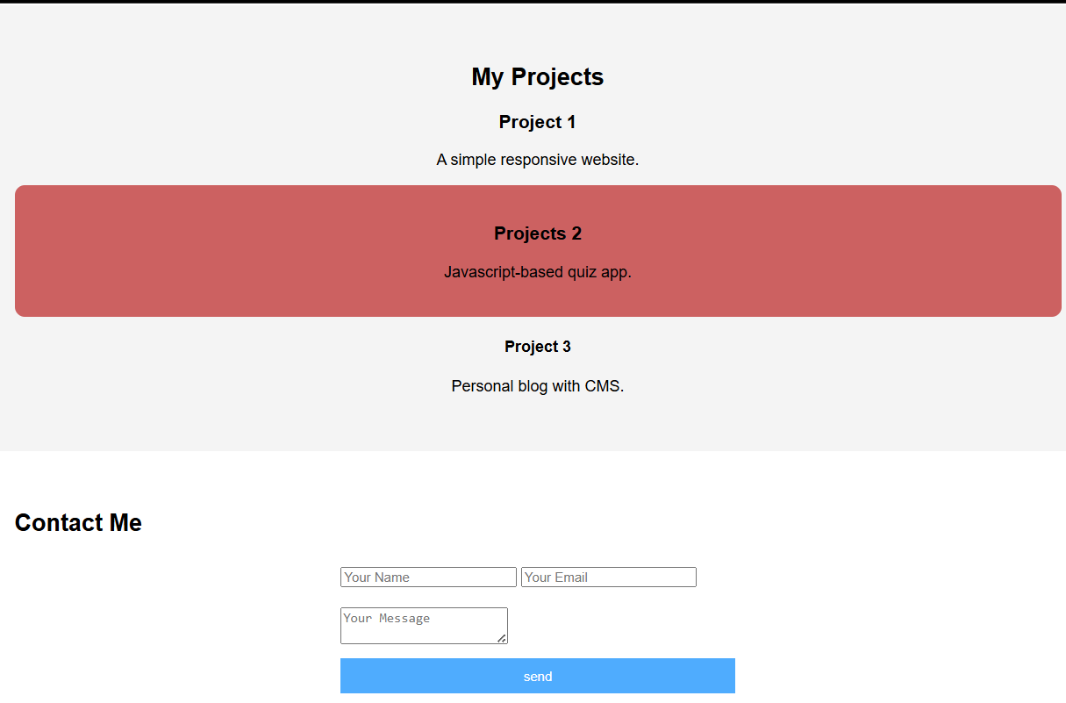
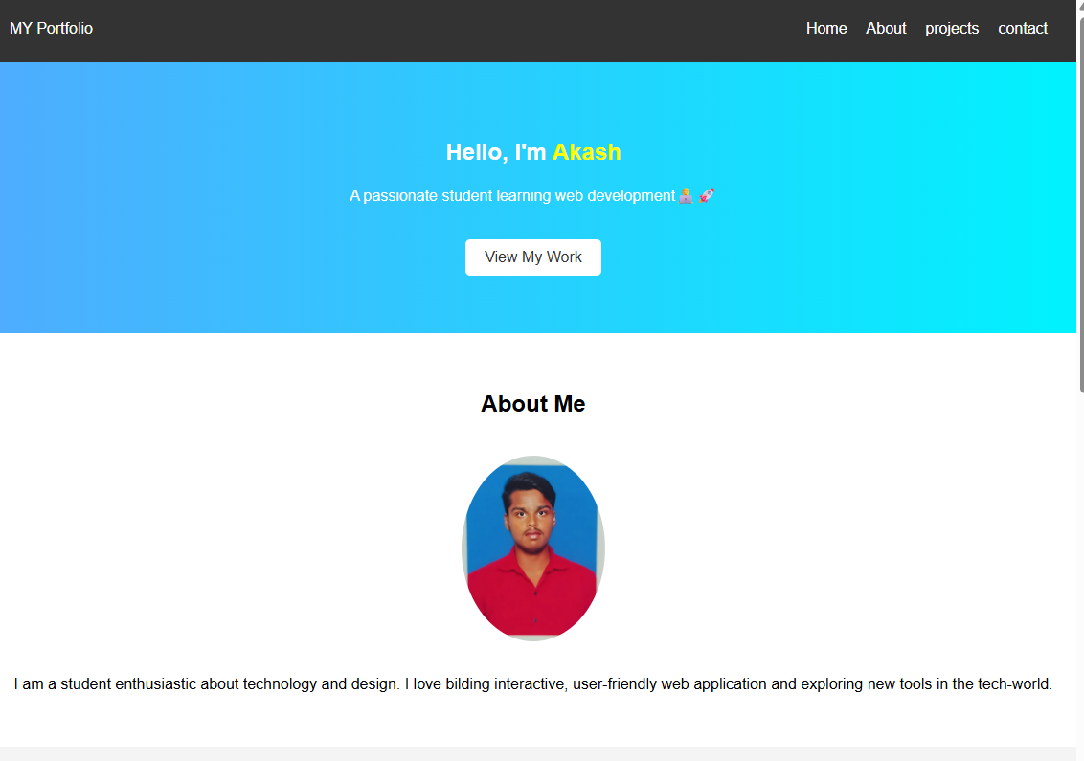
RESULTS AND SCREENSHOT
Results of my portfolio

Slide 11
CONCLUSION
This project helped me understand how web pages are built and styled. I learned how to organize content, use basic tags, and apply CSS rules. I also got familiar with GitHub and how to share my work online.

